Slide 1
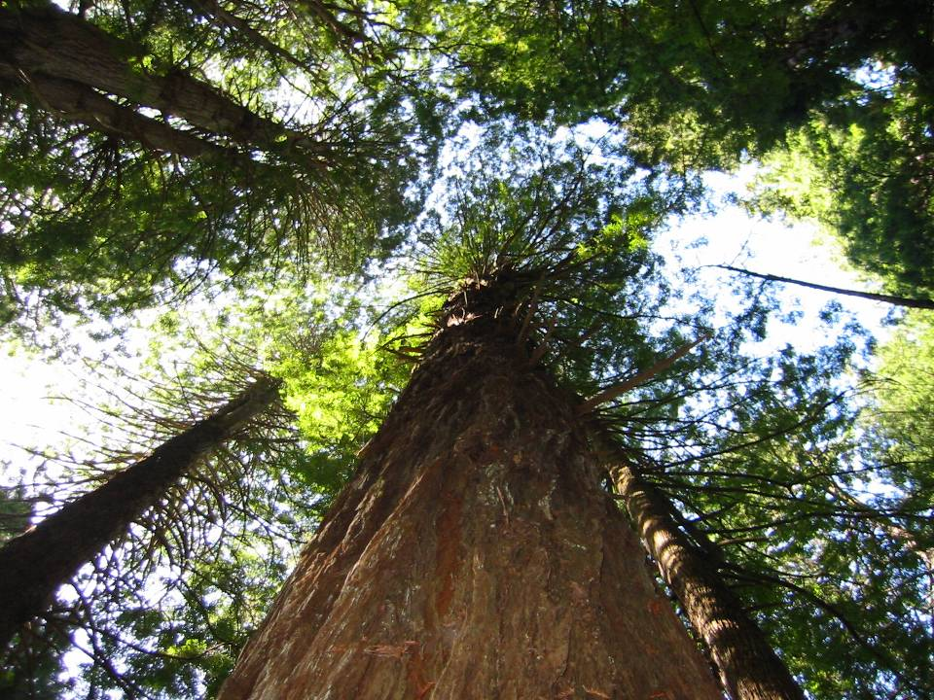
Notes:
Admittedly, Redwood National Park is famous for trees - not rocks. These monsters do a pretty good job of obscuring the geology, except …

Slide 2
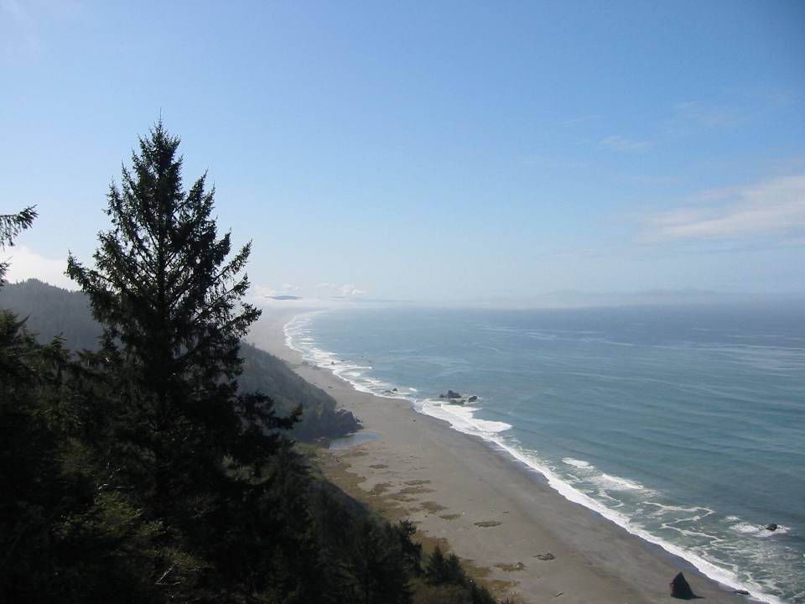
Notes:
… along the coast, which is pretty much the only place in the park one can see much geology. Fortunately there are about 50 miles of coastline to work with in Redwood National Park.

Slide 3
LESSON OVERVIEW
Coastal Landforms
Accretionary Wedge Composition
Notes:
In this lesson we will first examine the park’s coastal landforms and then take a detailed look at the composition of the accretionary wedge here. We will also want to understand how and why this wedge is different than the one in Olympic National Park.

Slide 4
COASTAL LANDFORMS
Embayments
Marine Terraces
Sea Stacks
Notes:
First let’s examine the formation of coastal embayments.

Slide 5
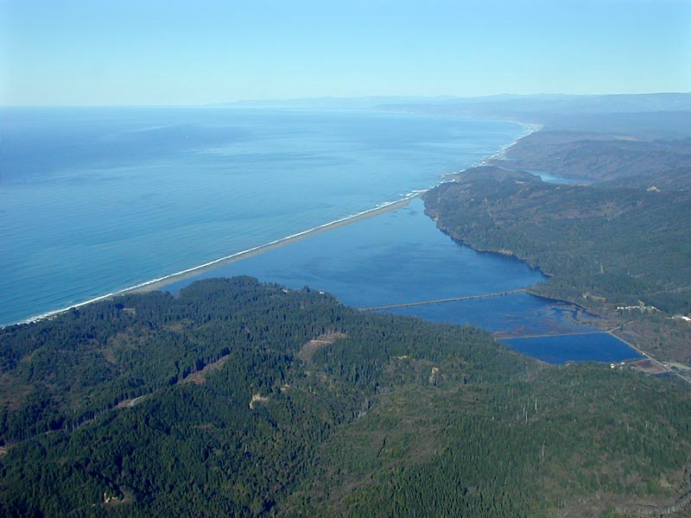
Stone Lagoon
Big Lagoon
Notes:
Big Lagoon and Stone Lagoon are good examples of the numerous coastal embayments that occur in and near Redwood National Park.

Slide 6
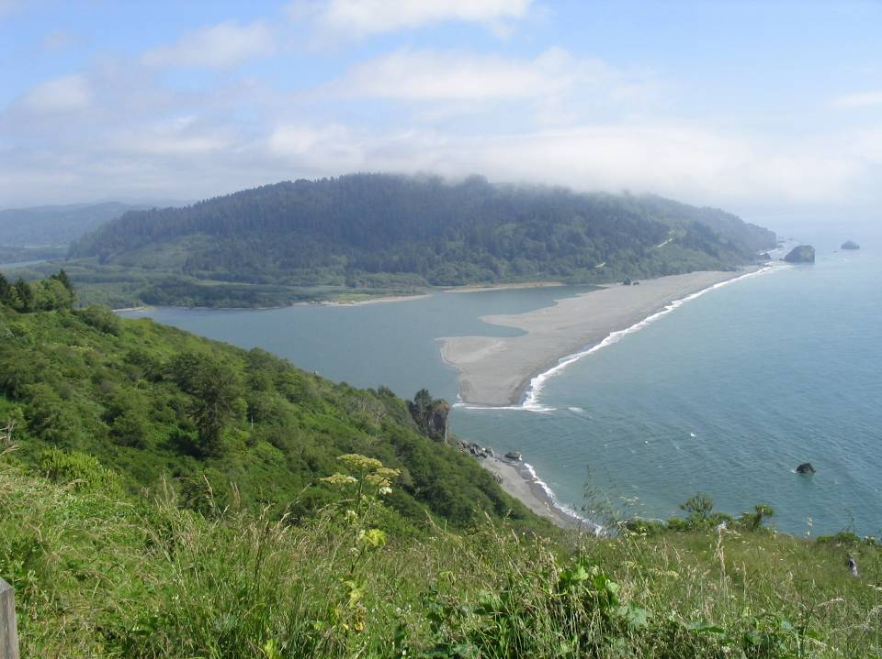
Klamath River Mouth
Notes:
Another is the Klamath River mouth. Notice how the ocean covers a large portion of the Klamath River valley. To understand how this happened, it is helpful to know that sea level during the last ice age was about 130 meters lower than it is today. So during the ice ages, this view would have looked something like …

Slide 7
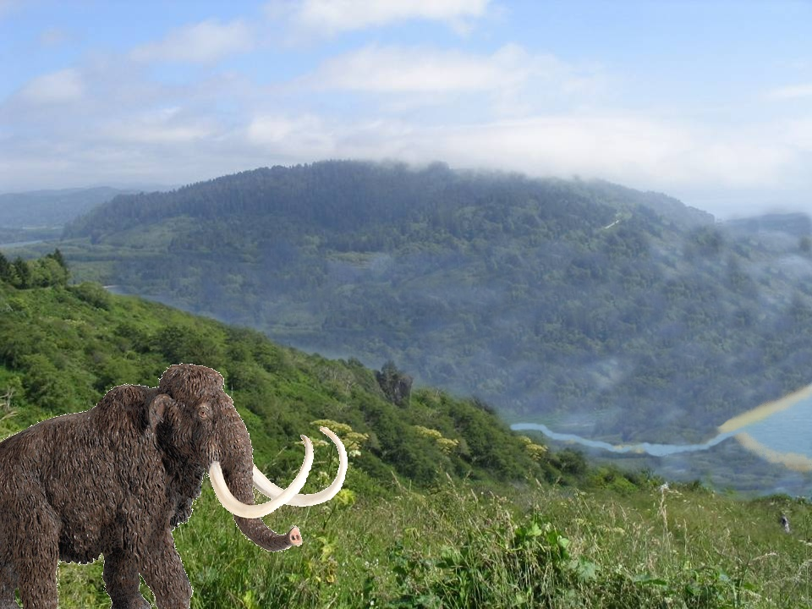
That’s gonna be a long walk.
Notes:
… this. The Klamath River would have flowed much further west across the continental shelf towards the lower sea level. It would also have carved a canyon down to the lower sea level, which as sea level rose following the ice ages, …

Slide 8
Notes:
… would become the first area submerged by the rising ocean. Most of the canyon is filled by river sediments ….

Slide 9
Baymouth Bar
Notes:
… that get reworked and reshaped by wave action into baymouth bars.

Slide 10
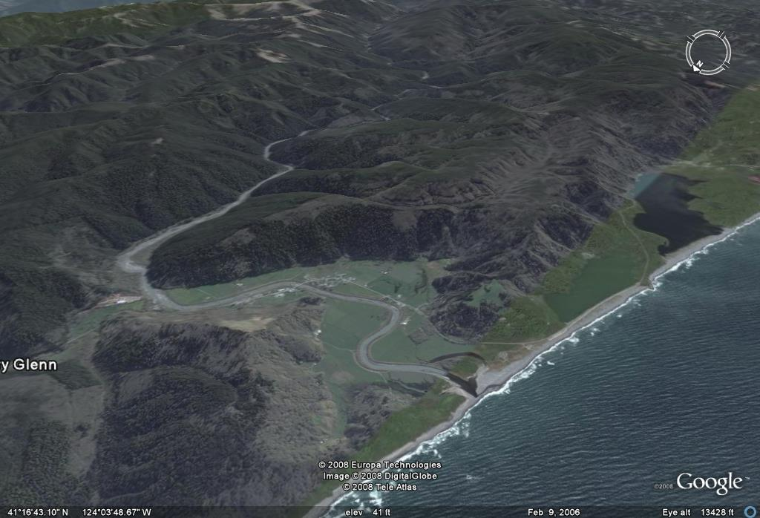
Redwood Creek
Notes:
You can get a good idea of how embayments form if you visualize what would happen if sea level rose on the present landscape. Here we see the mouth of Redwood Creek with the present sea level.

Slide 11
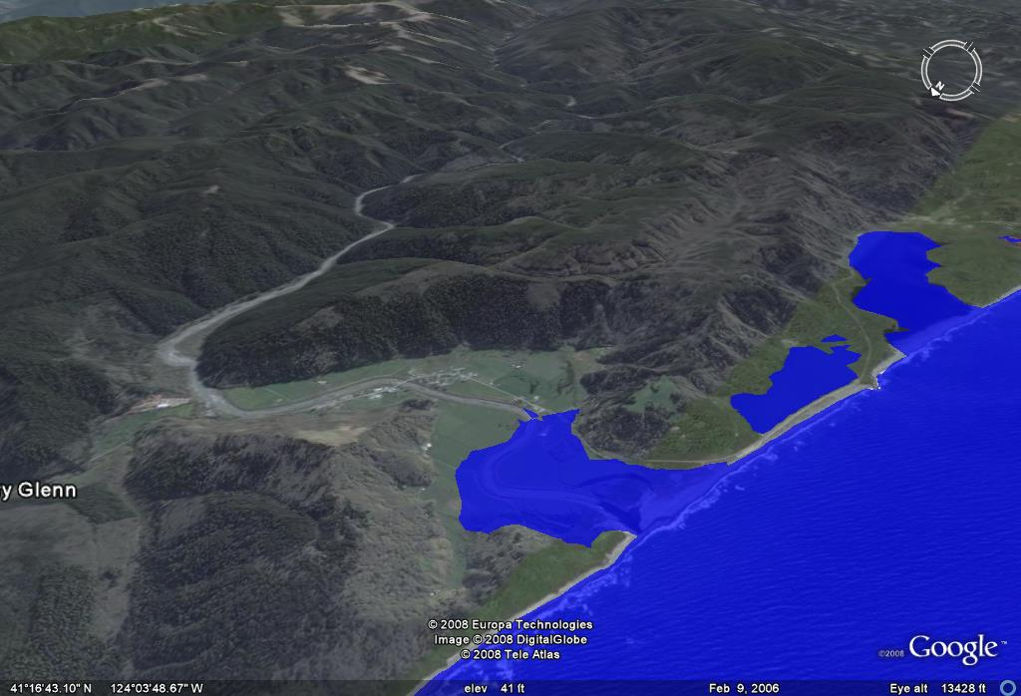
Notes:
Now a 5 meter rise in sea level …

Slide 12
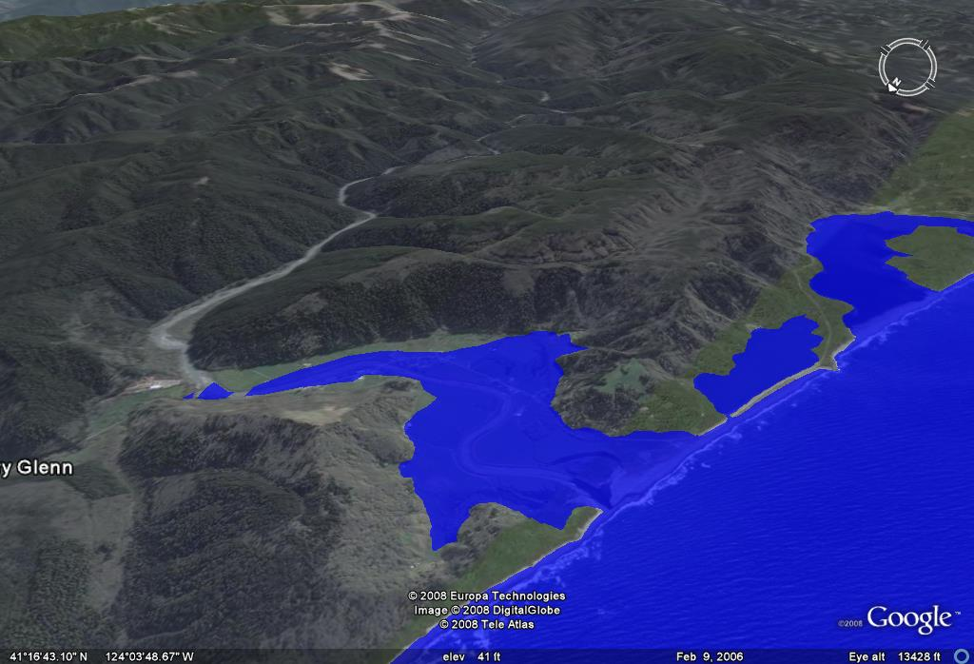
Notes:
… and a 10 meter rise ….

Slide 13
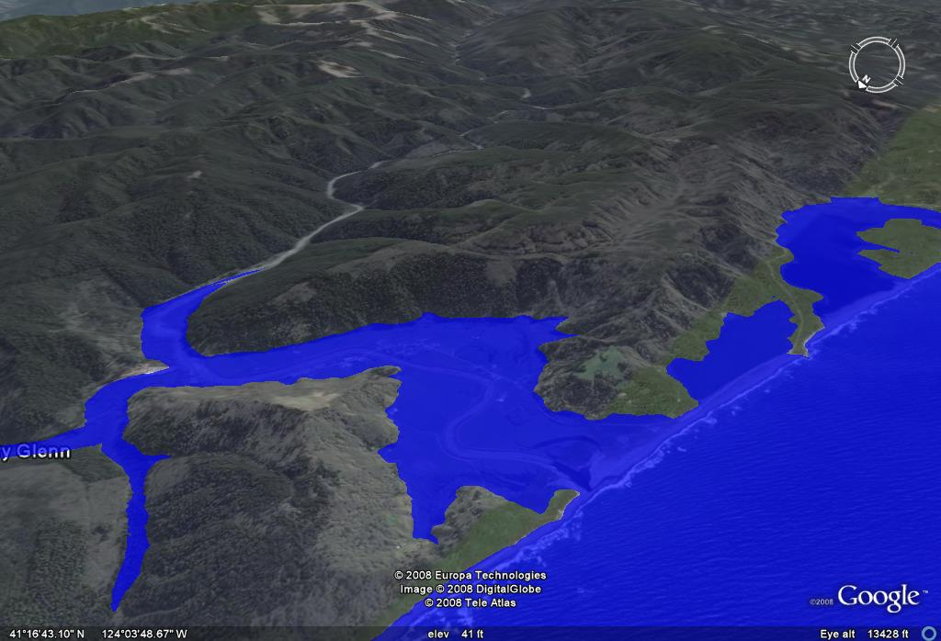
Notes:
… 15 meter …

Slide 14
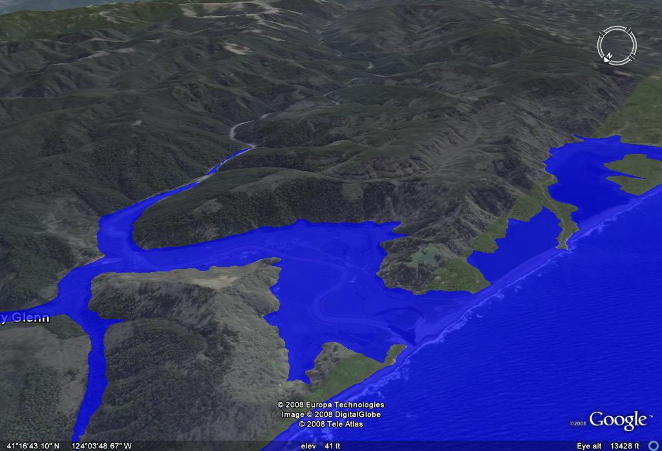
Notes:
… and 20 meter rise. You can see that the river canyons get flooded and become embayments. Embayments are common in and around Redwood National Park because deep river canyons extend all the way to the coast where they can be submerged by rising sea level.

Slide 15
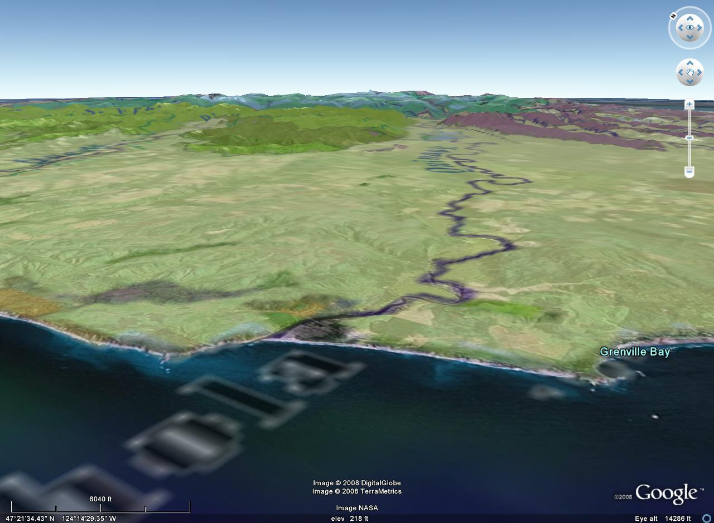
Olympic National Park
deep canyons
MARINE TERRACE
Notes:
Such is not the case for Olympic National Park where deep canyons only occur in the Olympic Mountains. Embayments are not a prominent feature of Olympic National Park primarily because its accretionary wedge is only 20 million years old. The relatively recent uplift of the Olympic wedge resulted in the deposition of vast amounts of sediment derived from the erosion of the Olympic Mountains. This blanket of sediment, was uplifted to become the marine terrace that exists today, however this relatively young terrace has not yet been dissected by rivers or eroded back to the Olympic Mountains where there are deep canyons. Without canyons to submerge, coastal embayments will not form.

Slide 16
COMPARISON OF ACCRETIONARY WEDGES
PARK | AGE | SUBDUCTION RATE | SEDIMENATION RATE | COMPOSITION | COASTAL LANDFORMS
OLYMPIC | YOUNG | SLOW | HIGHEST | Turbidite, basalt, limestone, quartz veins | Marine terraces, stacks, arches, tombolos
REDWOOD | OLD | SLOW | HIGHER | MELANGE: (basalt, peridotite, chert, greywacke, argillite) | Marine terraces, stacks, arches, tombolos, drowned river valleys
KENAI FJORDS | MIDDLE | MODERATE | HIGH | HIGH Ophiolite, granite, mélange | Fjords, stacks, arches
Notes:
On the other hand, the Redwood accretionary wedge is much older, so sediments derived from its erosion have been completely eroded, …

Slide 17
Stone Lagoon
Big Lagoon
Notes:
… and canyons carved into the older wedge are in a position to be drowned by the present high sea levels. Notice that a broad marine terrace does not exist here like in Olympic National Park.

Slide 18
COASTAL LANDFORMS
Embayments
Marine Terraces
Notes:
Marine terraces do exist along the Redwood coast but they are relatively narrow.

Slide 19
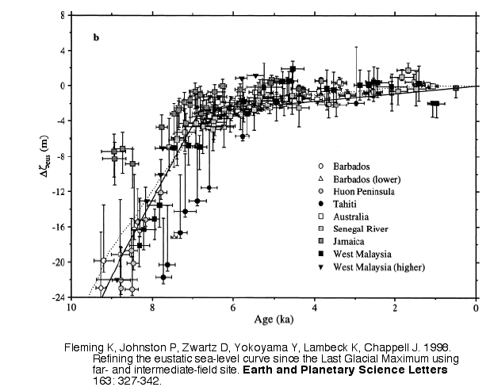
slow rise
rapid rise
Notes:
This graph illustrates one of the key principles in marine terrace formation. It shows the rise in sea level since the last ice age 10,000 years ago. Notice that the rate of change was very rapid for about 3,000 after the last glacial period, but then it stabilized, and has only risen slightly over the last 7,000 years. Similarly, when headed into a glacial period, sea level falls rapidly at first and then stabilizes at the lower glacial sea level.

Slide 20
Marine Terrace Formation
Notes:
Notice the rapid rise, stabilization, rapid fall and stabilization again of sea level. When sea level is stable, wave erosion forms a wave cut platform at the shoreline. This will happen during both during low and high sea level stands. But as wave cut platforms form and sea levels change, the land slowly uplifts, such that older wave cut platforms are elevated above younger platforms. The elevated wave cut platforms are now called marine terraces. Usually marine terraces will occur at several at different elevations, forming massive coastal stairways, with the lowest steps being the youngest. Level ground near the coast is irresistible to developers, but the “prime” beach front lots may not be excellent long term investments.

Slide 21
MARINE TERRACE
Notes:
To spot marine terraces look for flat areas above sea cliffs. The lowest terrace is the youngest.

Slide 22
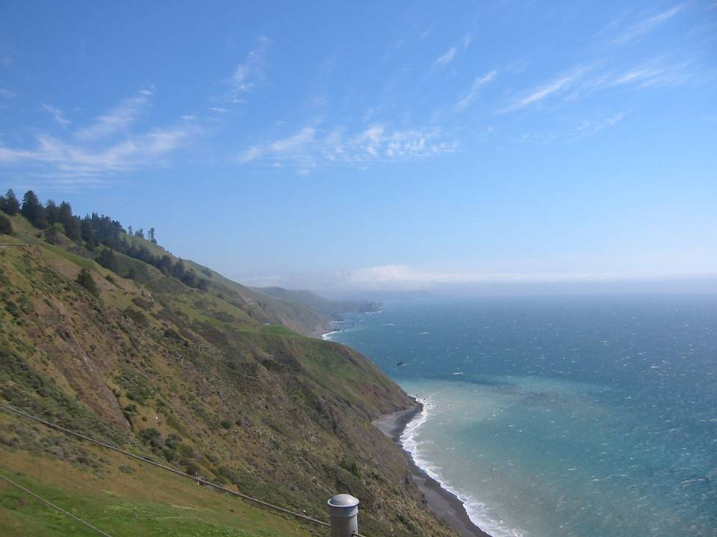
Older Marine Terrace
Notes:
Higher terraces are older and generally more discontinuous as they have been more thoroughly dissected by stream erosion and undermined by wave action.

Slide 23
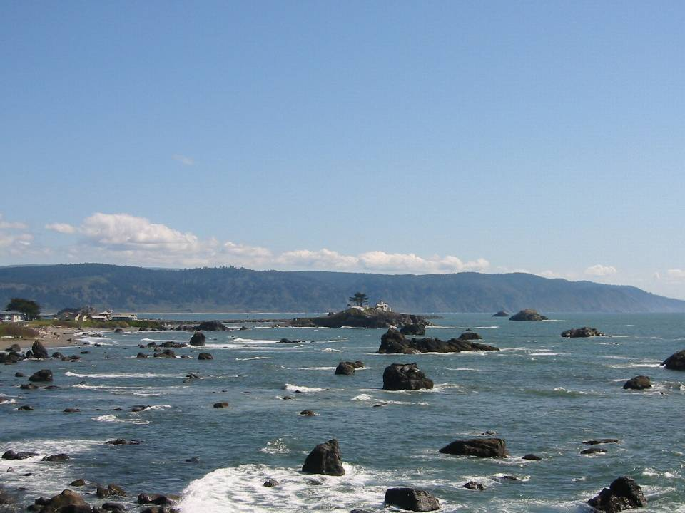
Stable pre-glacial sea level?
Notes:
The highest terrace is broadest and probably represents a peneplain or vast wave cut platform eroded during stable pre-Pleistocene sea levels.

